Slide 1
Project –> E-Commerce Company
MySQL

Slide 2
Problem Statement
1) You can analyze all the tables by describing their contents.
2) Identify the top 3 cities with the highest number of customers to determine key markets for targeted marketing and logistic optimization.
3) As per the last query's result, Which of the cities must be focused as a part of marketing strategies?
4) Determine the distribution of customers by the number of orders placed. This insight will help in segmenting customers into one-time buyers, occasional shoppers, and regular customers for tailored marketing strategies.

Slide 3
Problem Statement
5) As per the Engagement Depth Analysis question, What is the trend of the number of customers v/s number of orders?
6) As per the Engagement Depth Analysis question, Which customers category does the company experiences the most?
7) Identify products where the average purchase quantity per order is 2 but with a high total revenue, suggesting premium product trends.
8) Among products with an average purchase quantity of two, which ones exhibit the highest total revenue?

Slide 4
Problem Statement
9) For each product category, calculate the unique number of customers purchasing from it. This will help understand which categories have wider appeal across the customer base.
10) As per the last question, Which product category needs more focus as it is in high demand among the customers?
11) Analyze the month-on-month percentage change in total sales to identify growth trends.
12) As per Sales Trend Analysis question, During which month did the sales experience the largest decline?

Slide 5
Problem Statement
13) As per Sales Trend Analysis question, What could be inferred about the sales trend from March to August?
14) Examine how the average order value changes month-on-month. Insights can guide pricing and promotional strategies to enhance order value.
15) As per last question, Which month has the highest change in the average order value?
16) Based on sales data, identify products with the fastest turnover rates, suggesting high demand and the need for frequent restocking.

Slide 6
Problem Statement
As per last question, Which product_id has the highest turnover rates and needs to be restocked frequently?
18) List products purchased by less than 40% of the customer base, indicating potential mismatches between inventory and customer interest.
19) Why might certain products have purchase rates below 40% of the total customer base?

Slide 7
Problem Statement
20) After running an analysis to identify products purchased by less than 40% of the customer base, it was found that a few products have lower purchase rates than expected. What could be a strategic action to improve the sales of these underperforming products?
21) Evaluate the month-on-month growth rate in the customer base to understand the effectiveness of marketing campaigns and market expansion efforts.
22) As per last question, What can be inferred about the growth trend in the customer base from the result table?

Slide 8
Problem Statement
23) Identify the months with the highest sales volume, aiding in planning for stock levels, marketing efforts, and staffing in anticipation of peak demand periods.
24) As per last question, Which months will require major restocking of product and increased staffs?

Slide 9
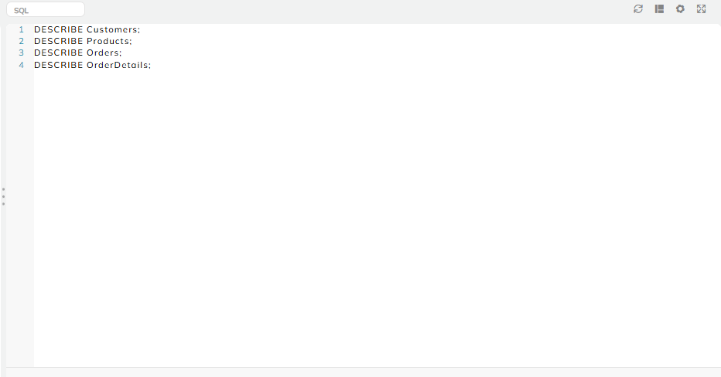
Output - 1

Slide 10
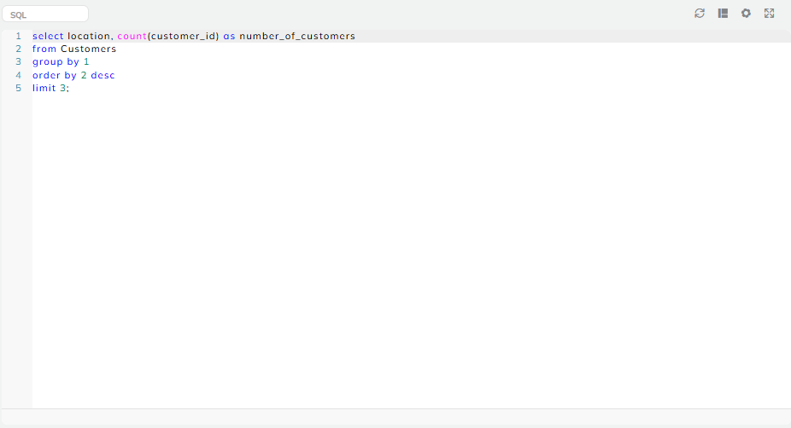
Output - 2

Slide 11
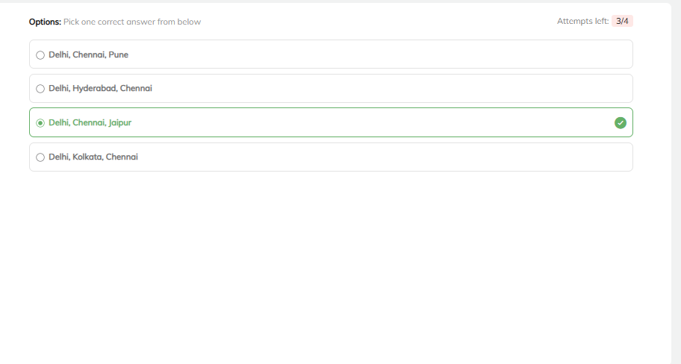
Output - 3

Slide 12
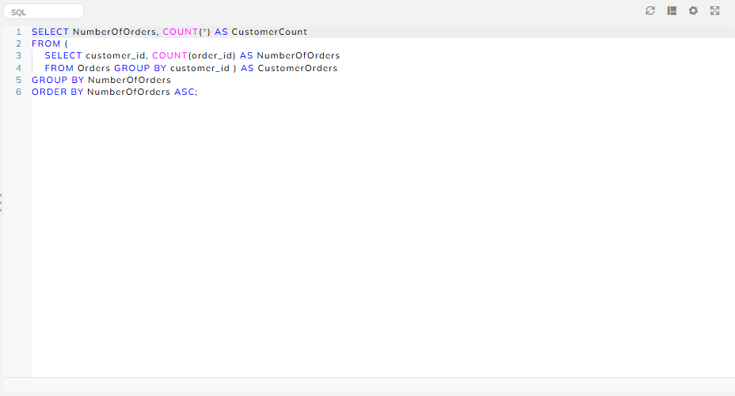
Output - 4

Slide 13
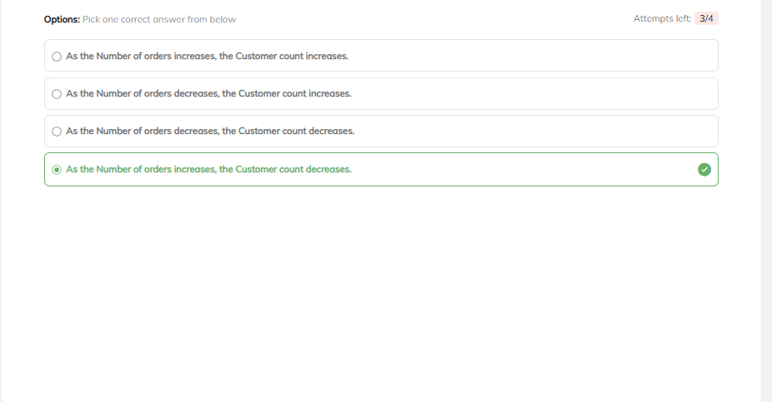
Output - 5

Slide 14
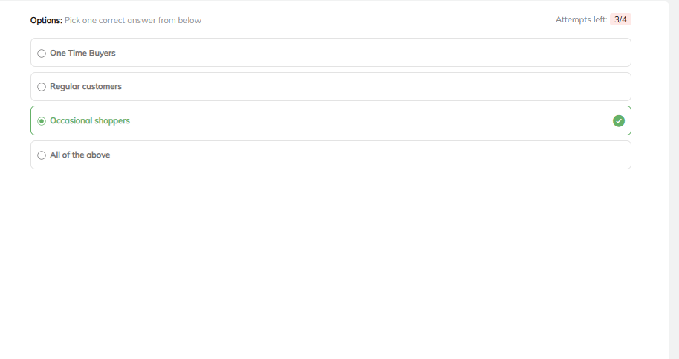
Output - 6

Slide 15
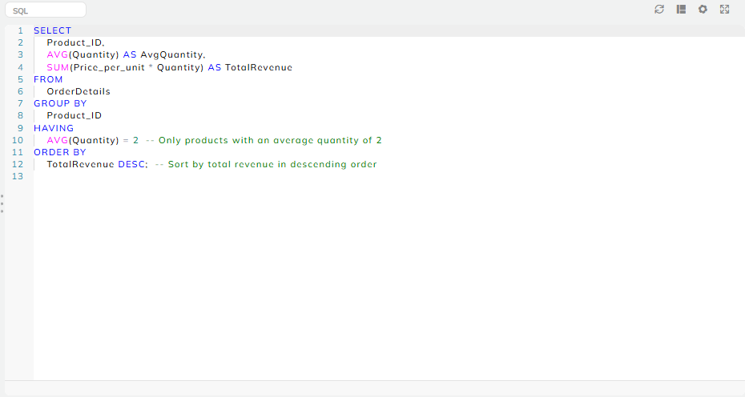
Output - 7

Slide 16
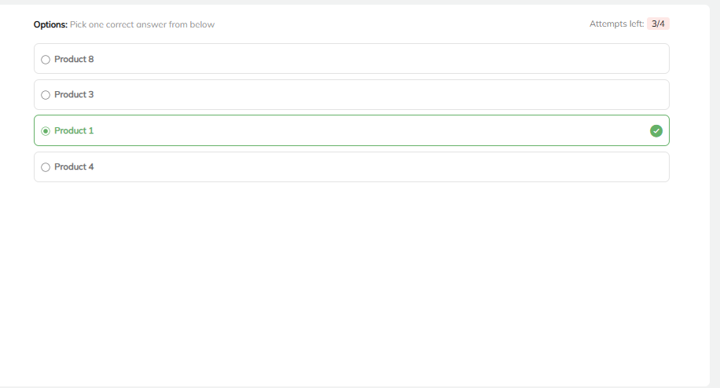
Output - 8

Slide 17
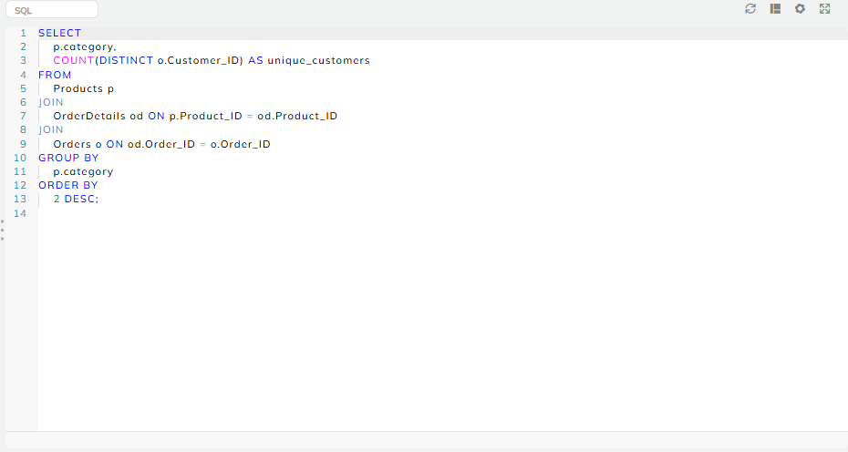
Output - 9

Slide 18
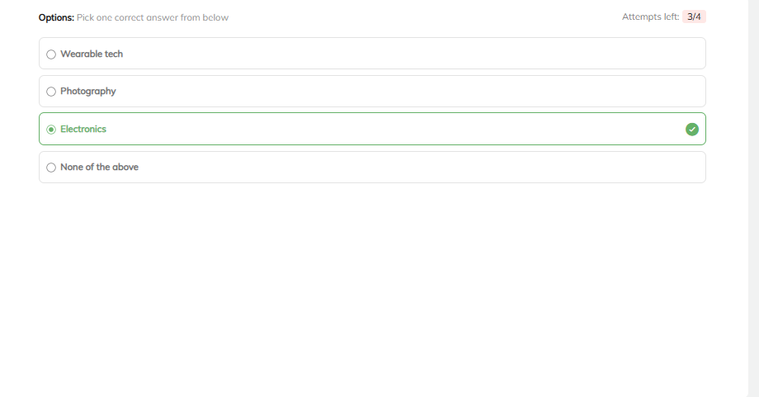
Output - 10

Slide 19
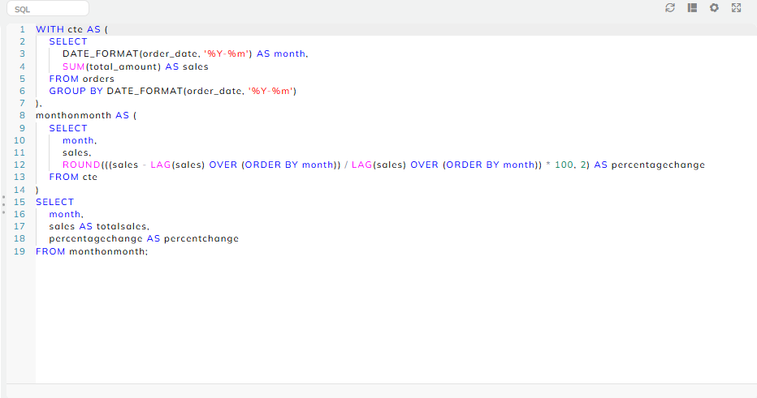
Output - 11

Slide 20
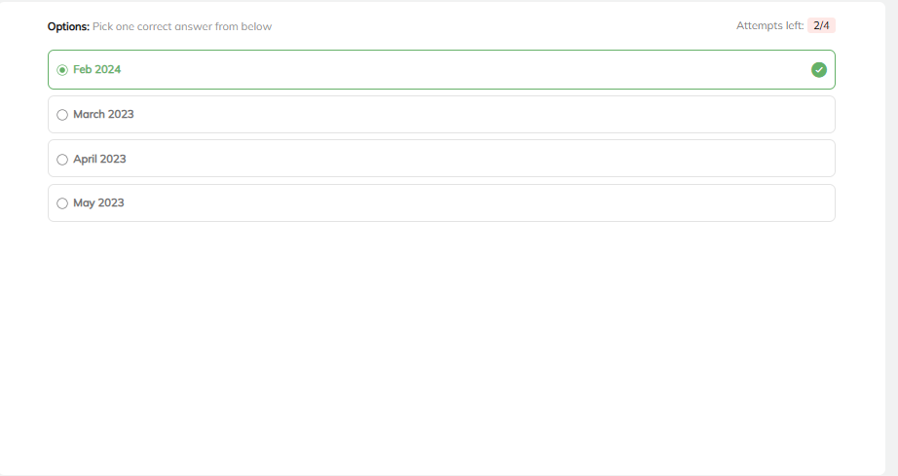
Output - 12

Slide 21
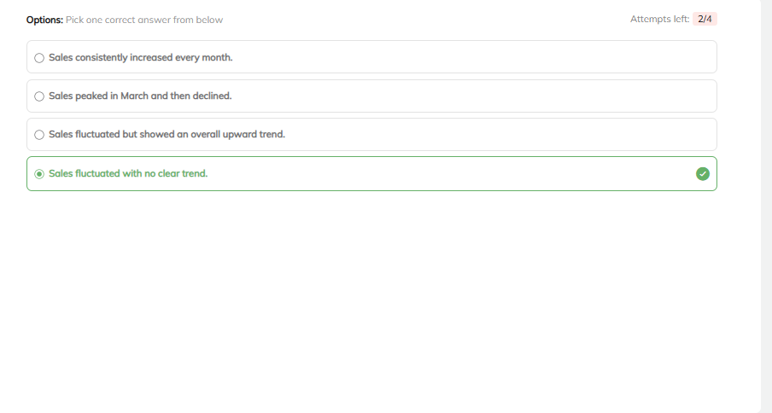
Output - 13

Slide 22
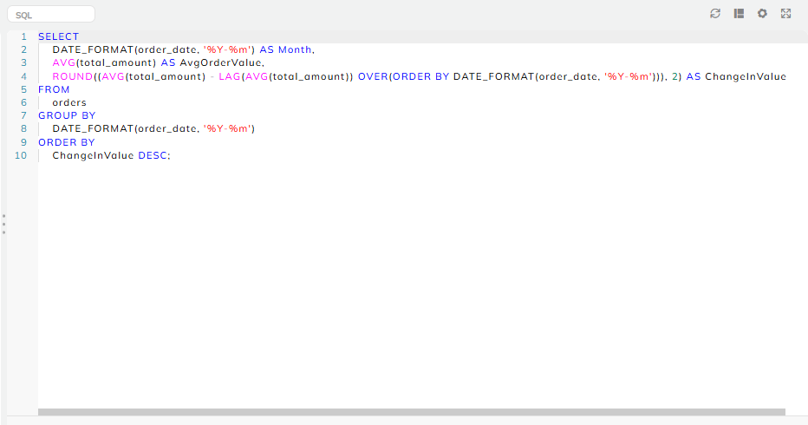
Output - 14

Slide 23
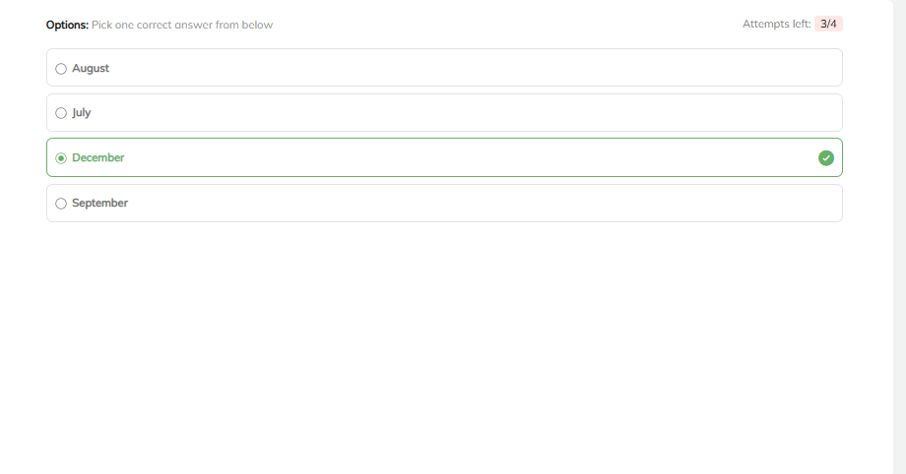
Output - 15

Slide 24
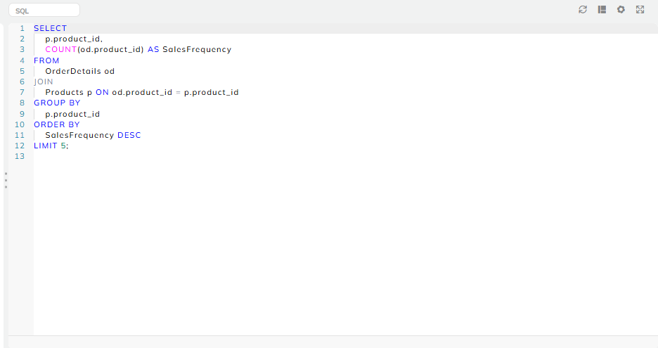
Output - 16

Slide 25
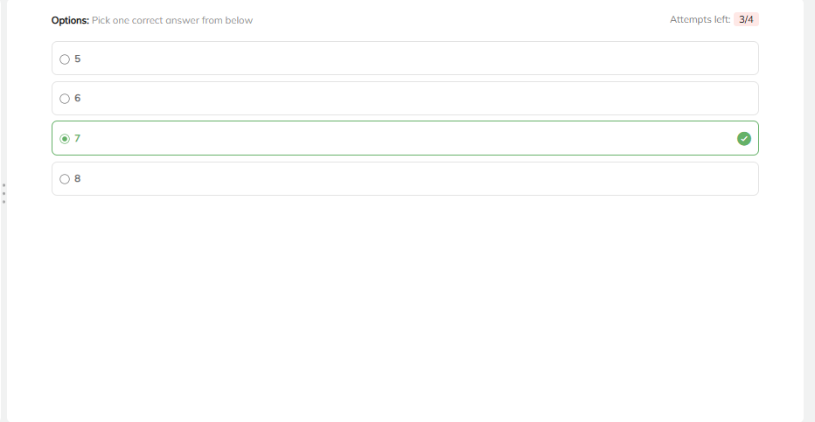
Output - 17

Slide 26
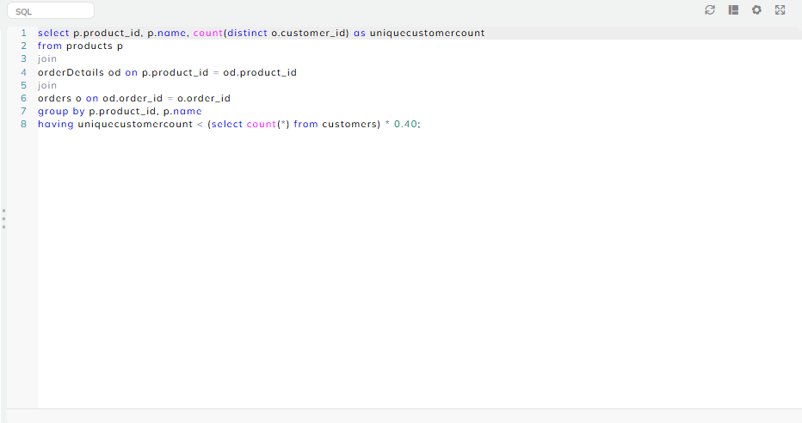
Output - 18

Slide 27
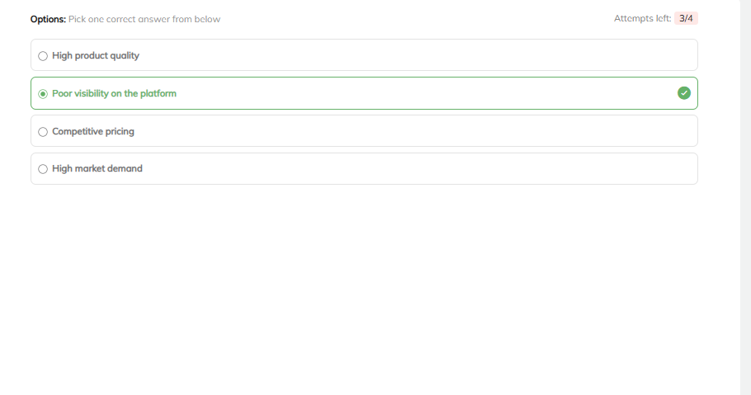
Output - 19

Slide 28
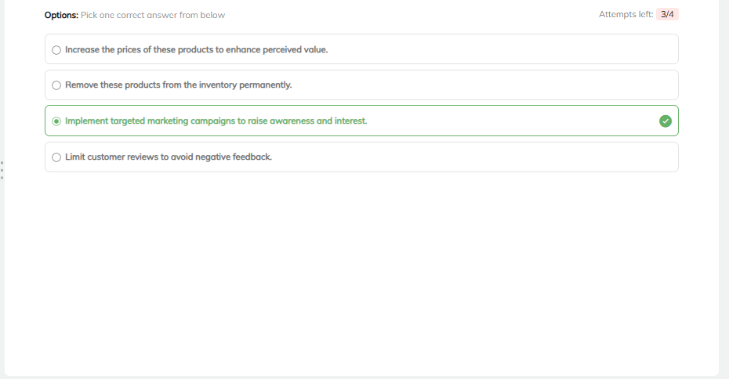
Output - 20

Slide 29
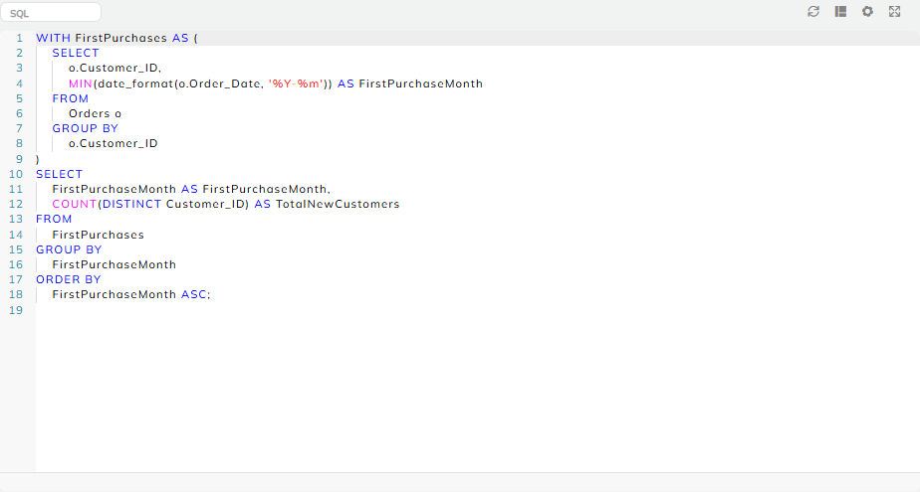
Output - 21

Slide 30
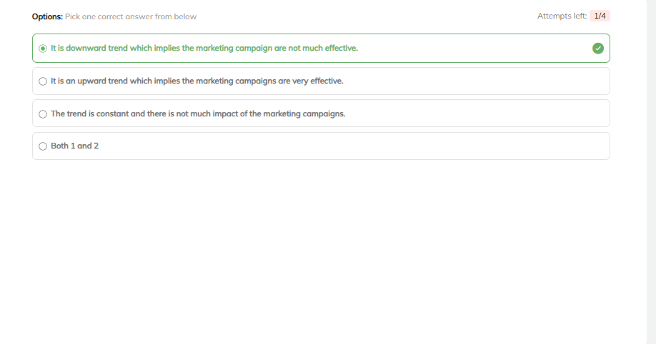
Output - 22

Slide 31
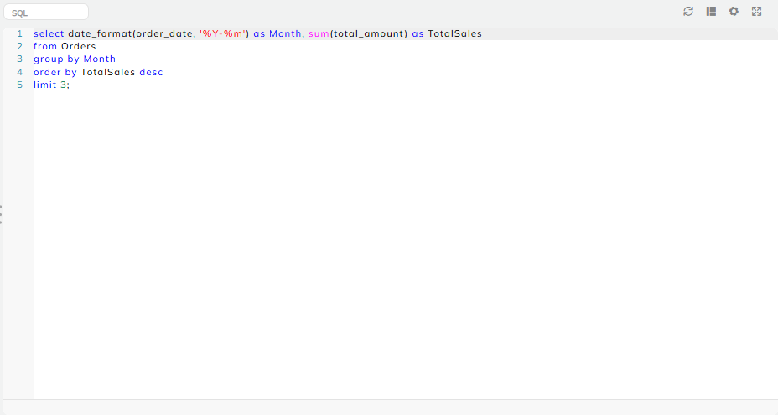
Output - 23

Slide 32
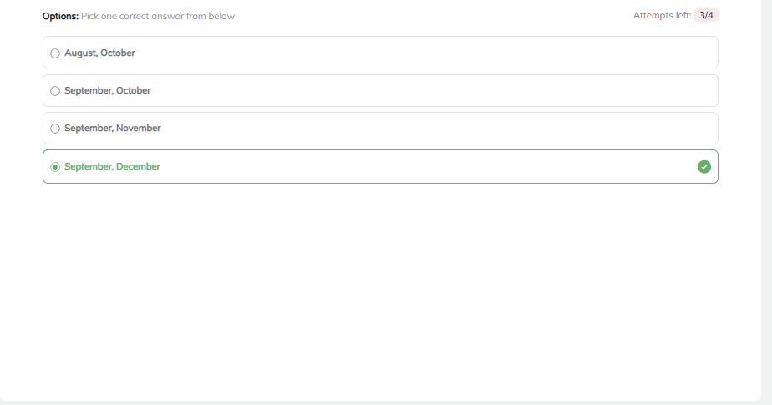
Output - 24

Slide 33


